Slide 1
Lab 7 – Critical Timeslot Detection (RDD API)
Structured Hints and Transformation Steps
Big Data Processing and Analytics (2025/26)
Professor: Paolo Garza
Teaching Assistants: Lorenzo Vaiani & Etibar Vazirov

Slide 2
Step 1: Load & Clean Data
Goal:
  Load register.csv
  Remove header
  Filter out invalid rows:
  (usedSlots = 0 AND freeSlots = 0)
Hint (Transformation):
  line → keep / discard
Explanation:
These rows represent broken sensor measurements. Keep only meaningful data.

Slide 3
Step 2: Parse Timestamp
Extract from each reading:
  Weekday (Mon, Tue, ...)
  Hour (0–23)
Hint (Transformation):
  (timestamp) → (weekday, hour)
Explanation:
We categorize readings by recurring weekly patterns, ignoring exact dates.

Slide 4
Step 3: Build Key–Value Pairs
For each reading, define:
Key:
  (stationId, weekday, hour)
Value:
  (1, fullFlag)
where:
  1 = total reading counter
  fullFlag = 1 if freeSlots == 0
  fullFlag = 0 otherwise
Hint (Transformation):
  line → ((stationId, weekday, hour), (1, fullFlag))
Explanation:
This prepares the data for ReduceByKey to aggregate counts.

Slide 5
Step 4: Aggregate Counts
For each (stationId, weekday, hour):
  Compute:
    total readings
    full readings
Hint (Transformation):
  ((1,a), (1,b)) → (2, a+b)
Result:
  (stationId, weekday, hour) → (totalCount, fullCount)
Explanation:
We combine readings belonging to the same timeslot.

Slide 6
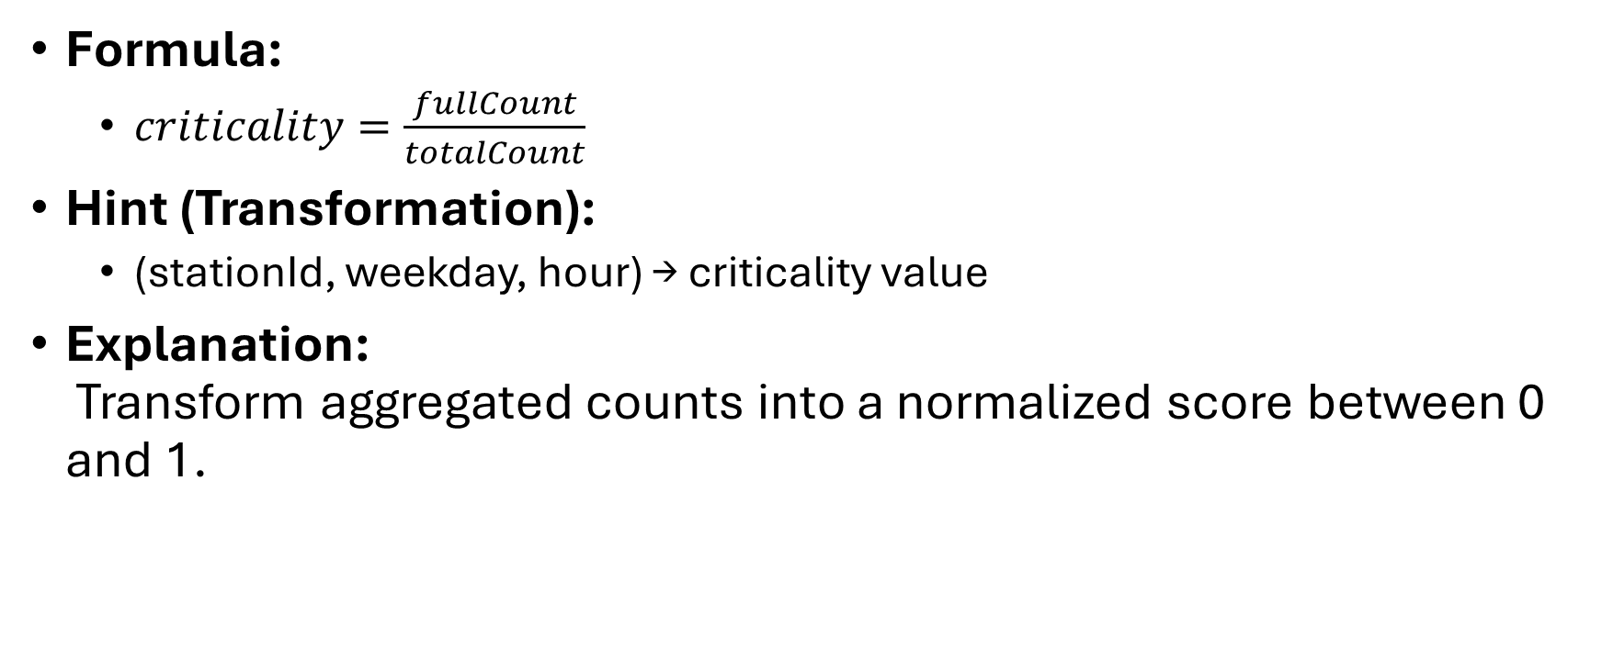
Step 5: Compute Criticality
Formula:
  $criticality=\frac{fullCount}{totalCount}$
Hint (Transformation):
  (stationId, weekday, hour) → criticality value
Explanation:
Transform aggregated counts into a normalized score between 0 and 1.

Slide 7
Step 6: Apply Threshold
Keep only timeslots where:
  criticality ≥ threshold
Hint (Transformation):
  (stationId, day, hour, criticality) → keep / discard
Explanation:
This step filters out low-impact timeslots and keeps significant ones.

Slide 8
Step 7: Select Best Timeslot per Station
If same criticality:
  Choose earliest hour
  If tied → weekday alphabetically earliest
Hint (Logic):
  (stationId → [(day,hour,crit)...]) → (best timeslot)
Explanation:
We collapse all candidate timeslots of each station into exactly one.

Slide 9
Step 8: Join with Station Coordinates
Join with stations.csv:
Hint (Transformation):
  (stationId → bestTimeslotInfo)
  JOIN
  (stationId → (longitude, latitude))
Result:
  stationId → (weekday, hour, criticality, longitude, latitude)
Explanation:
Coordinates are needed to generate map markers.

Slide 10
Step 9: Generate KML Placemark & Save
For each station:
Generate a placemark containing:
  stationId
  weekday
  hour
  criticality
  longitude, latitude
Hint (Transformation):
  (stationId, data) → "<Placemark>...</Placemark>"
Explanation:
We convert results into a format viewable on Google Maps.

Slide 11
Full Transformation Summary
Pipeline Overview:
  raw line
  → filtered line
  filtered line
  → (stationId, weekday, hour)
  → ((stationId, weekday, hour), (1, fullFlag))
  → aggregate counts (ReduceByKey)
  → criticality value
  → apply threshold
  → (stationId → best timeslot)
  → join with (longitude, latitude)
  → KML Placemark string
  → single output file

